Slide 1

PARKING MANAGEMENT SYSTEM

Slide 2
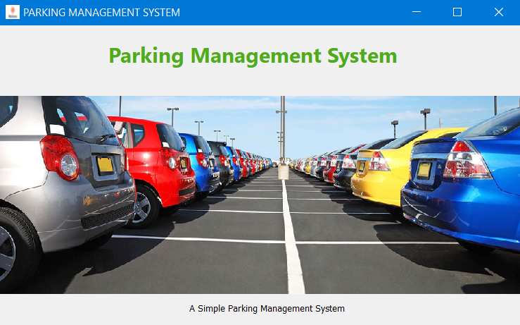

Slide 3
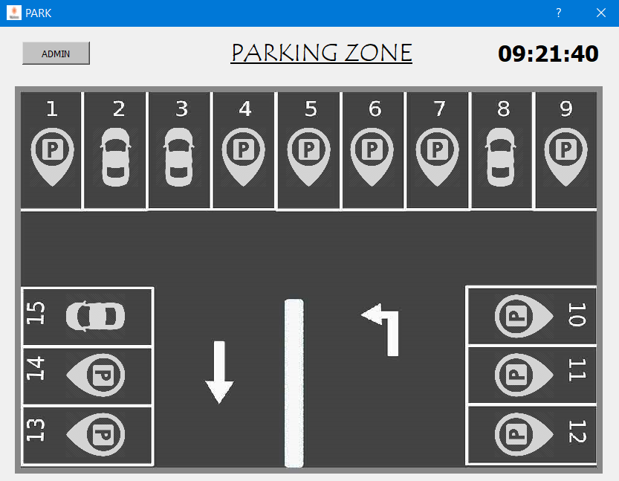
IN & OUT
BOOKED SLOT
EMPTY SLOT

Slide 4
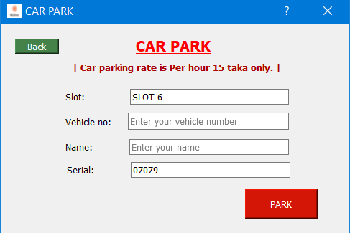
IN

Slide 5
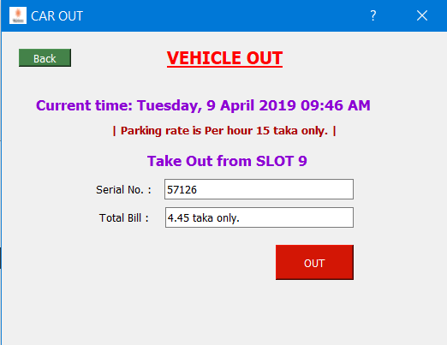
OUT

Slide 6
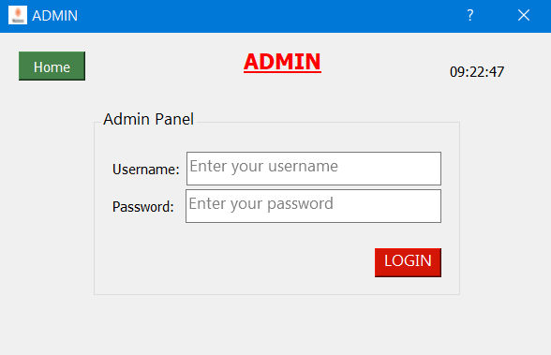
ADMIN LOGIN

Slide 7
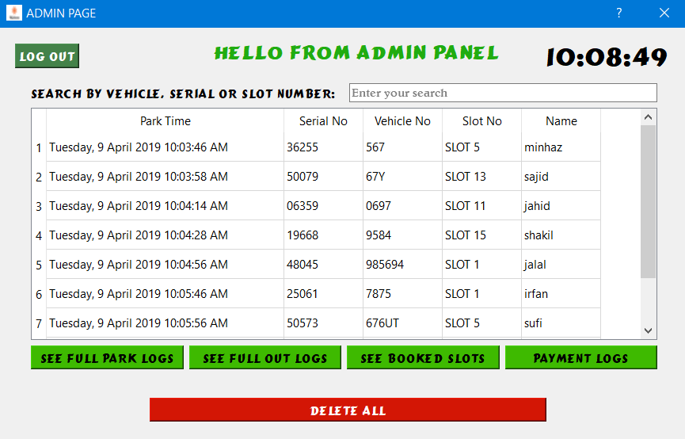
ADMIN ACCESS PAGE

Slide 8
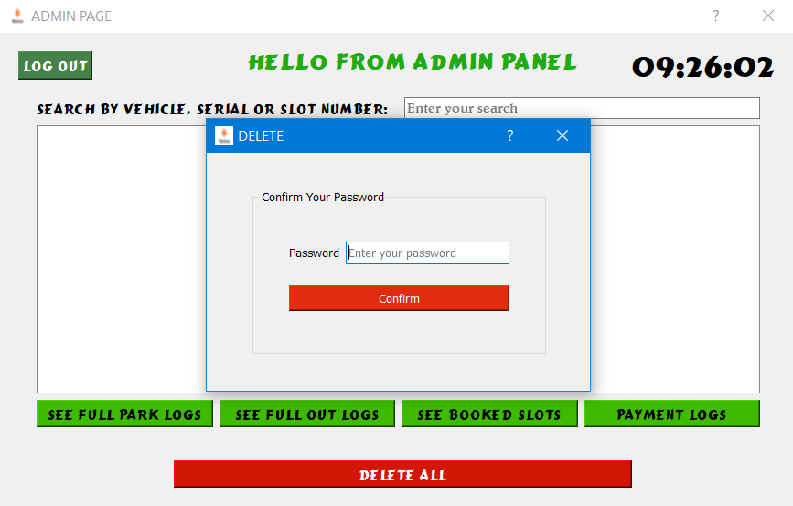
ALL HISTORY DELETE

